Slide 1
Sector Pathways Review
The Energy Transition
ICCN
2025

Slide 2






The Australian Parliament referred to the authority for review the potential technology transition and emission pathways that best support Australia’s transition to net zero emissions by 2050.
Sector Pathways Review: how can we get to net zero?
Six sectors
We explored:
What are the existing and prospective opportunities to achieve emissions reductions?
Which technologies may be deployed in each sector to support emissions reductions?
How can public and private finance support and align with these emissions pathways?
What are the barriers to implementation?
What are the workforce needs and inclusion challenges to address?
What gaps are there in existing evidence and data?
What else do governments, investors and communities need to know?
Electricity and energy
Transport
Industry and waste
Agriculture and land
We took into account:
the principles for the Climate Change Authority set out in section 12 of the Climate Change Authority Act 2011, including the global goals in Article 2 of the Paris Agreement and boosting economic, employment and social benefits; and
the range of emissions reductions achievable through the deployment of available and prospective technologies
Resources
Built environment

Slide 3

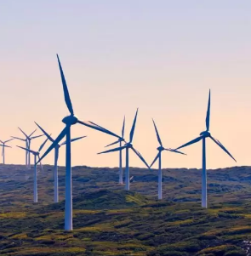


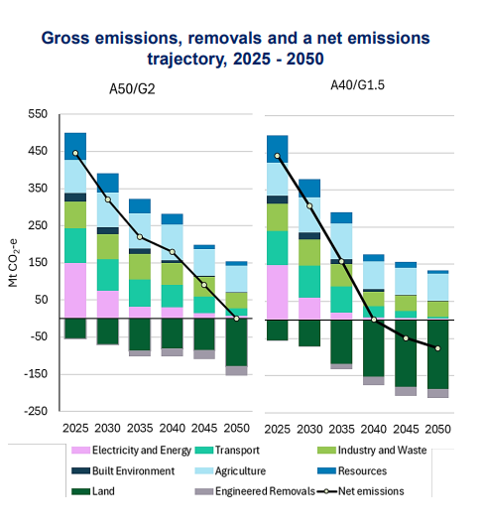

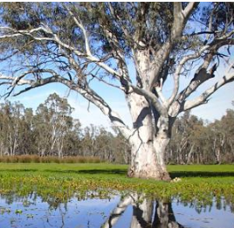

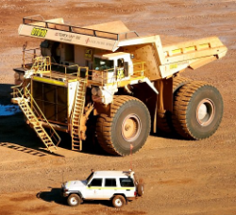
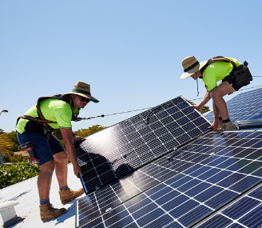

Key insights: Every sector of the economy must play its part
Every sector has some opportunities to cut emissions now. The pathways to net zero require coordinated action across all major sectors and sources of emissions.

Slide 4
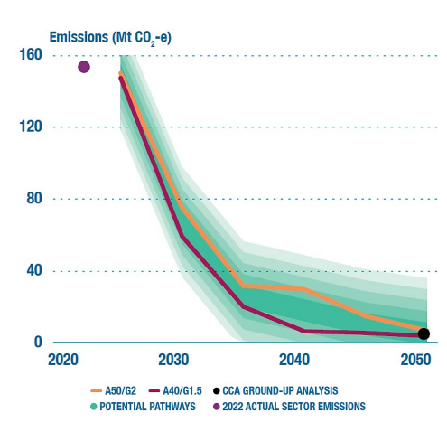
Key insights: Decarbonising electricity will unlock deep cuts to emissions
Getting more renewables and storage into our grid more quickly is essential to deal with the largest source of emissions and unlock reductions in other sectors.
Accelerating deployment of renewables and storage now is necessary to meet Australia’s 2030 renewable target, and to build industry, investment and supply chain capacity to keep scaling up clean electricity in the decades beyond.
New sources of essential system services will be required to maintain system security.
CSIRO – A50/G2 | CSIRO – A40/G1.5
Moderate global ambition consistent with <2 °C outcome | High global ambition consistent with 1.5 °C outcome
Australia achieves its current 2030 target and reaches net zero by 2050 | Australia overachieves on its 2030 target and reaches net zero by 2040

Slide 5



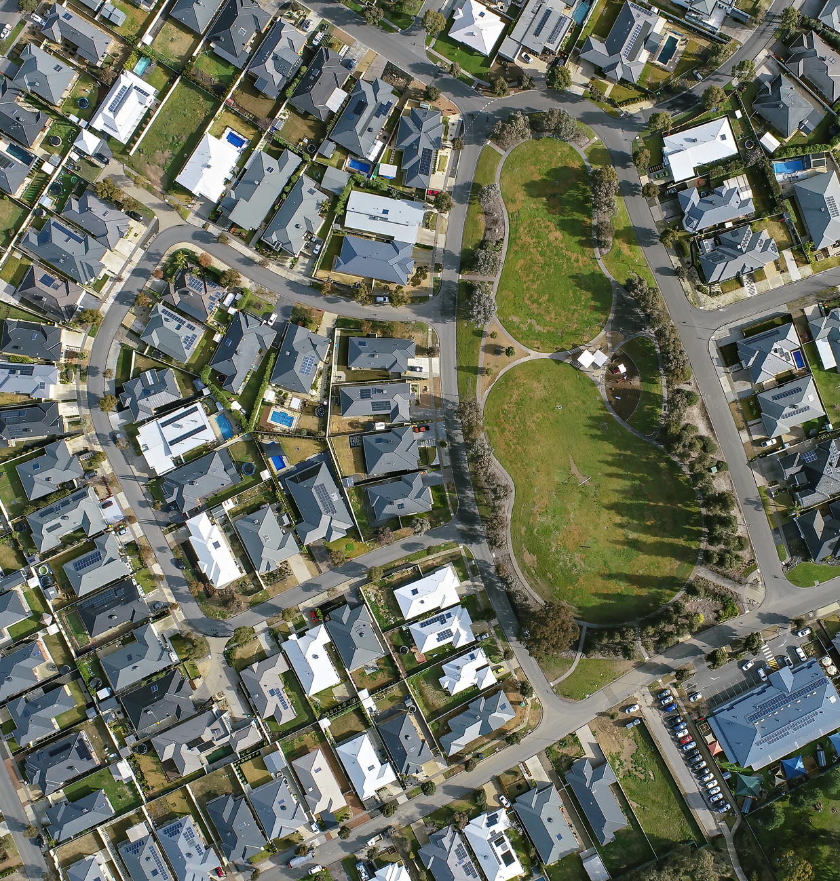








With the right strategies, we can get there
STRATEGY 1 | STRATEGY 2 | STRATEGY 3 | STRATEGY 4 | STRATEGY 5 | STRATEGY 6
Overcome the ‘green premium’ through fit-for-purpose policy interventions, including regulation, market-based mechanisms and government finance to leverage private investment. | Accelerate the deployment of net zero infrastructure by reforming planning and approvals processes, better coordinating business engagement, and the efficient development of renewable energy zones and clean industrial hubs. | Strengthen the foundations for social license through enhancing climate literacy, building capacity in business and communities to negotiate benefit and burden-sharing arrangements, and working with communities. | Think global, act local by working with international trade partners, governments and global institutions to find shared pathways to net zero that grow new markets and maintain energy security. | Rapidly address workforce shortages by diversifying and deploying a rapid skills program and enhancing workforce mobility. | Address information and data gaps by expanding, simplifying and automating data collection and dissemination.

Slide 6
Thank you
For more: Visit climatechangeauthority.gov.au
(and find us on LinkedIn).

